Slide 1

PEAK
Every Pottstown child will enter kindergarten ready to learn and achieve
Pottstown Early Action for Kindergarten Readiness
Notes:
Introductions

Slide 2
Overview of Pottstown
5.5 miles square – shares borders with Borough
3200 students (Pre-K through 12th grade)
100% free breakfast and lunch
  21% Special Education
  23% transiency rate
43% of housing renter occupied
  45% of the children ages 0-5 live in low income families
  30% of population lives at or below the poverty line
Per capita income of $20,923

Slide 3

Why Focus on Early Education
Research on impact of school readiness
Dissertation and findings
Regular education or special education
Notes:
Research connecting K readiness with 3rd grade reading and graduation rate
Dissertation and Findings
Cost of Special education remediation

Slide 4
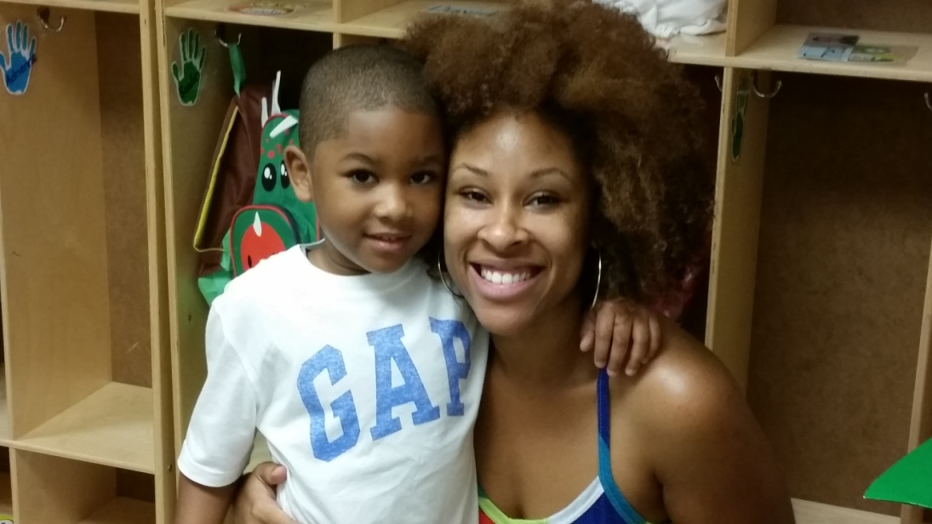
Pre-K Counts Public Private Partnership Grant
Planning grant
Bringing together stakeholders
Moving from competitors to partners
Identifying key strategy areas
Implementation grant

Slide 5
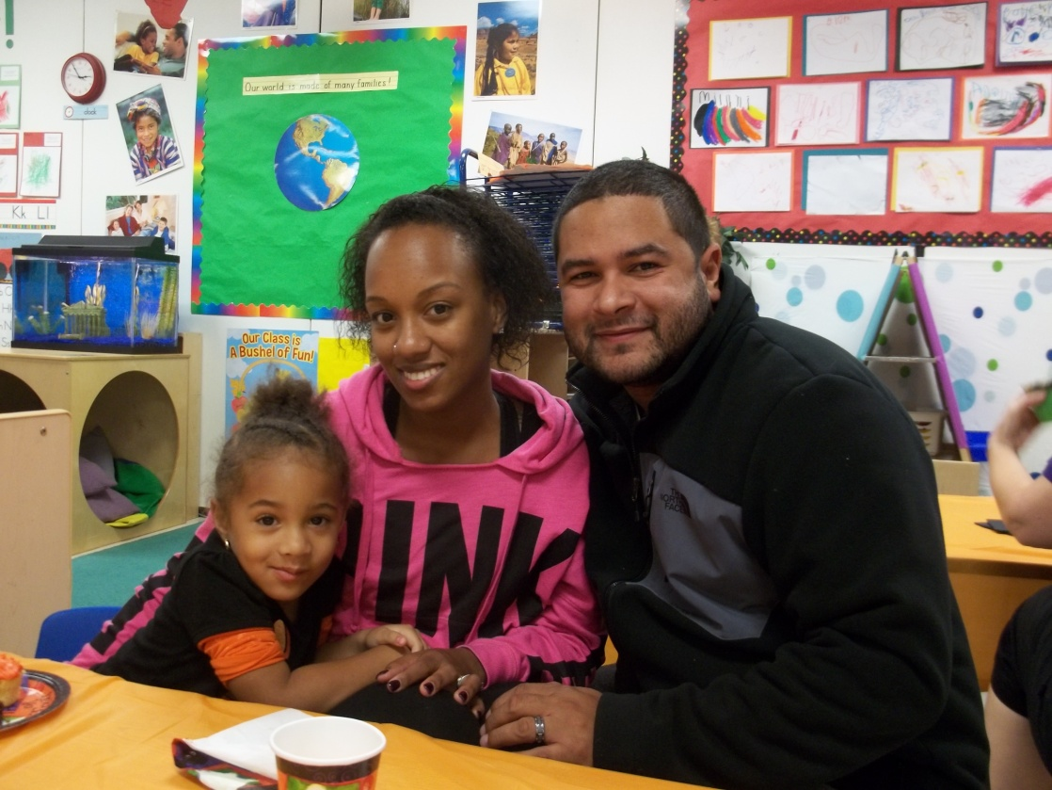
PEAK – The Beginning
Governance and Managing Partners
Developing systems for working with community based programs
Diversifying funding
Key strategy areas

Slide 6
PEAK Managing Partners
Pottstown School District
Maternity Care Coalition
Montgomery Early Learning Centers
Pottstown Family Center
Pottstown Area Health & Wellness Foundation
Pottstown YMCA
United Way of Greater Philadelphia and Southern New Jersey
YWCA Tri-County Area

Slide 7
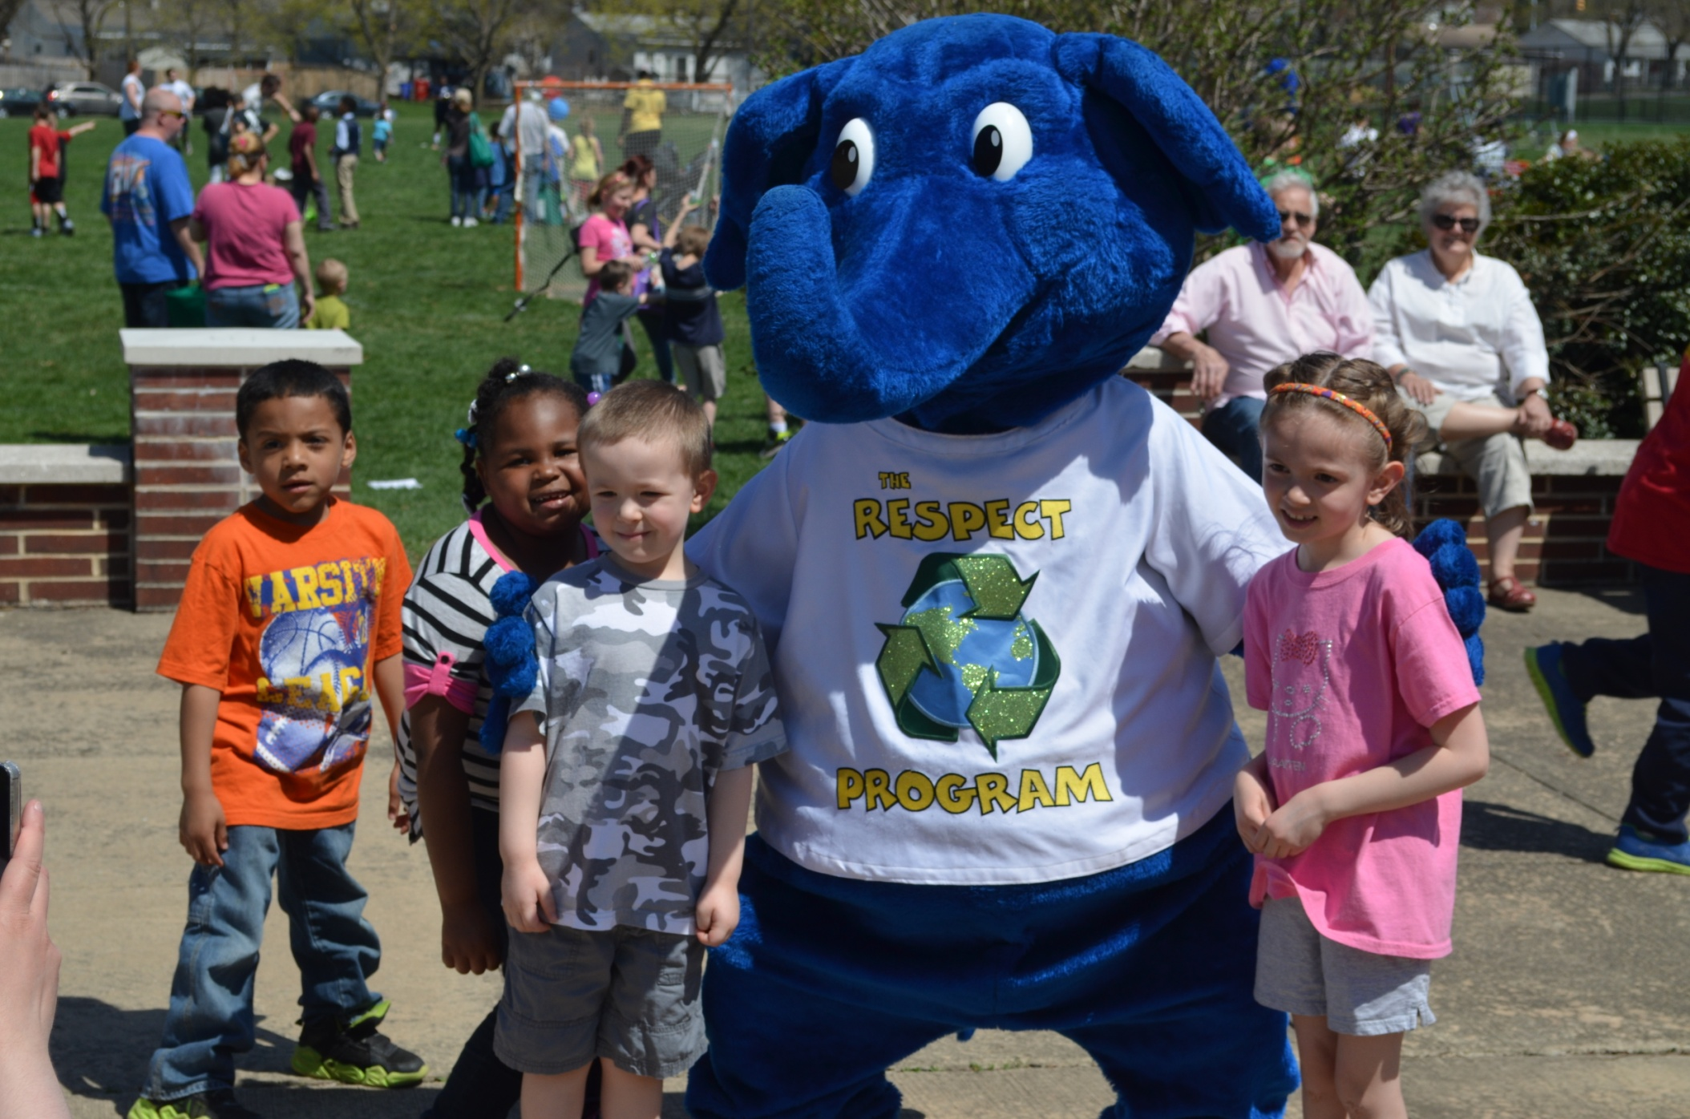
Strategic Areas
Community Outreach
Family Engagement
Quality Improvement and Work Force Development
Health and Wellness
Kindergarten Transition

Slide 8
Community Outreach
Increase awareness of early childhood education
Community partnerships
Community Events
  Month of the Young Child
  PEAK Annual Meeting

Slide 9
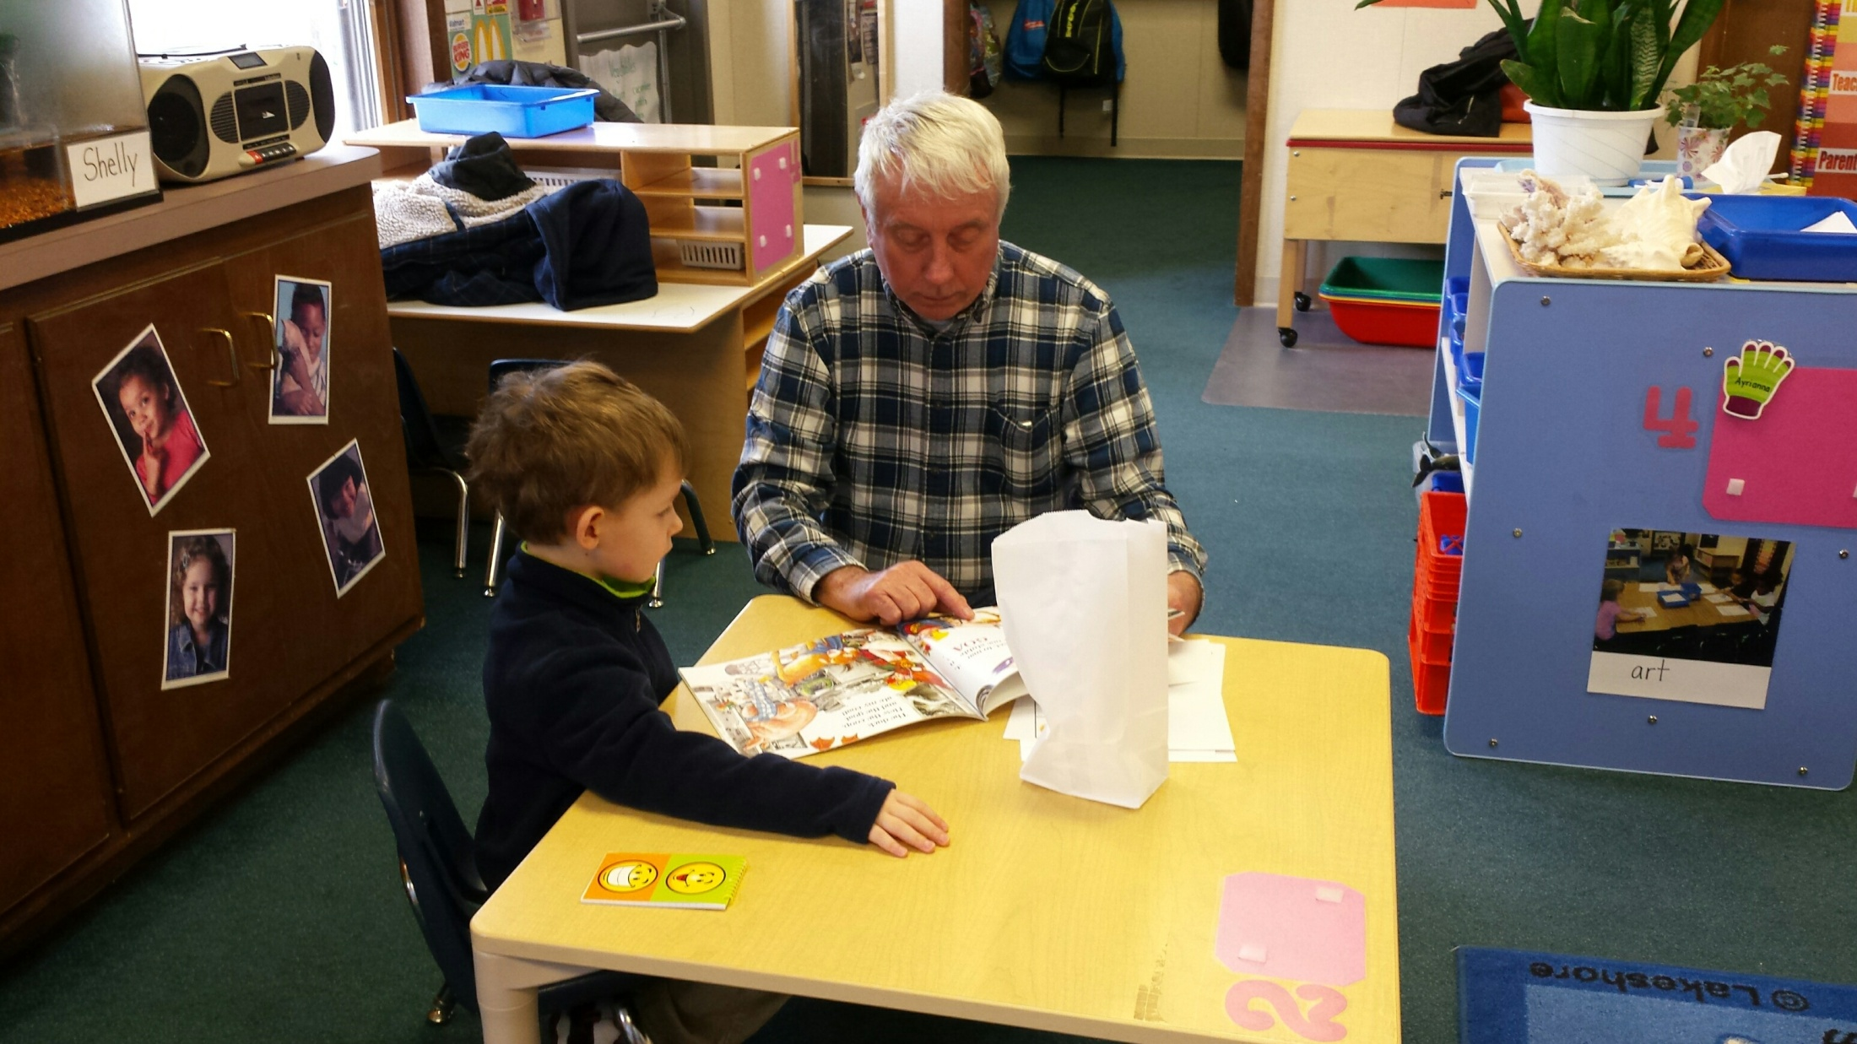
Family Engagement
Two generation approach
Partner with Pottstown Family Center
  Family Engagement Coordinator
  Bilingual Parent Specialist
Focus on protective factors
Partner with all agencies serving families with 0-5 children
Family Literacy Nights

Slide 10
POTTSTOWN SCHOOL DISTRICT in partnership with Step by Step Learning presents
Family LITERACY NIGHTS
Me, teach my child to read?
Yes, parents you can! It’s easy as…
Instill a lifelong love of reading in your child now!
2015 Dates:
September 15
October 6
October 27
November 17
December 8

Slide 11
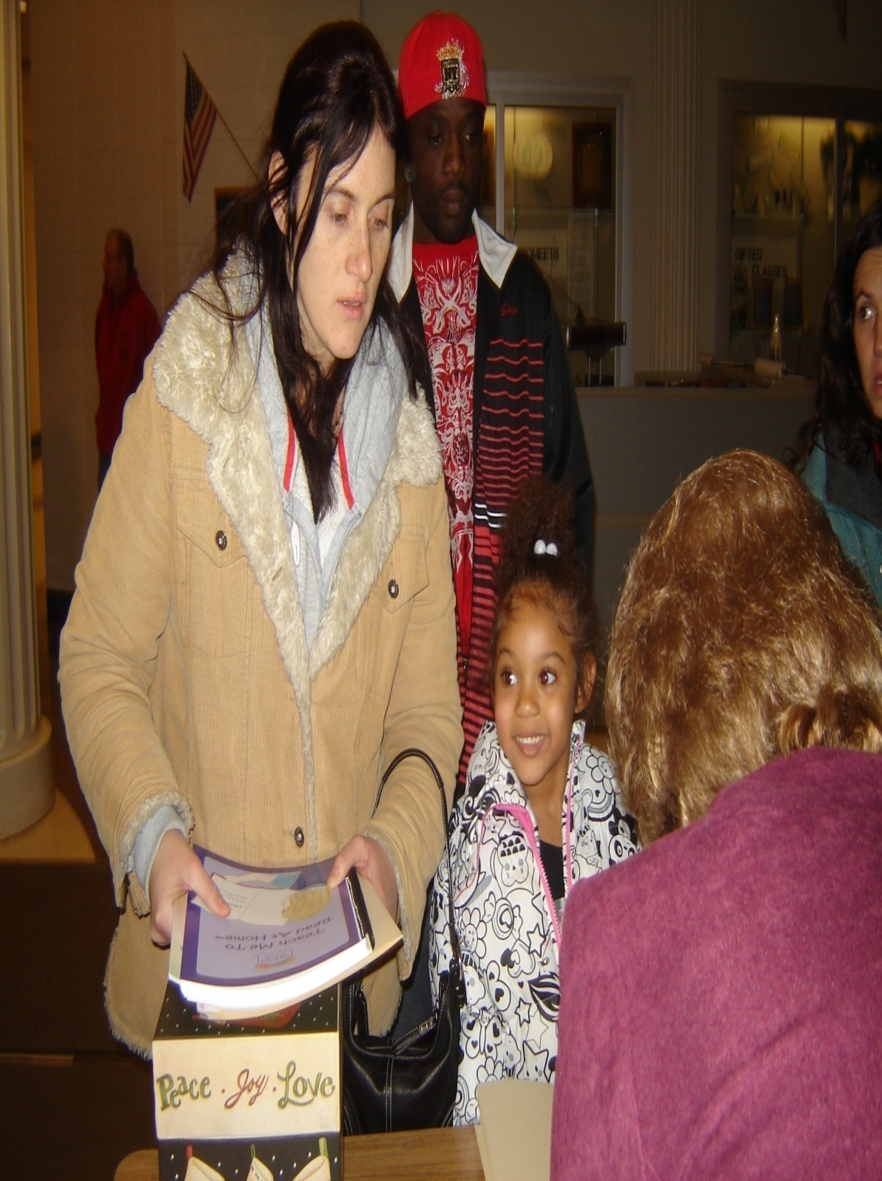
Pottstown PLN Community Wide Impact
Targets groups: PreK through 4th grade children of Pottstown
Provides families with the skills to support developing early literacy at home
Builds relationships between the school district and families in the community
Prepares children to be successful readers
Notes:
PEAK
Open to all for participation – PEAK support breakfast meetings – Literacy, math, Social skill development

Slide 12
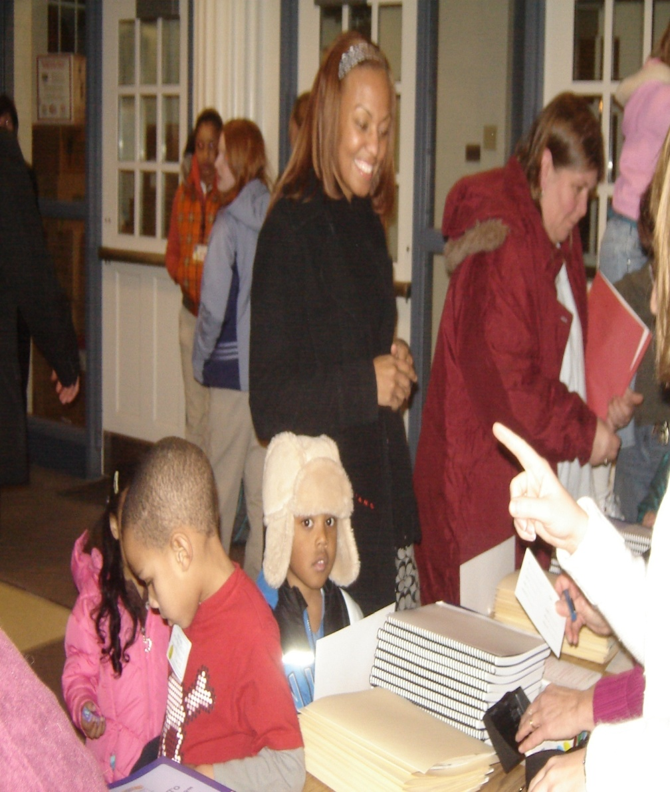
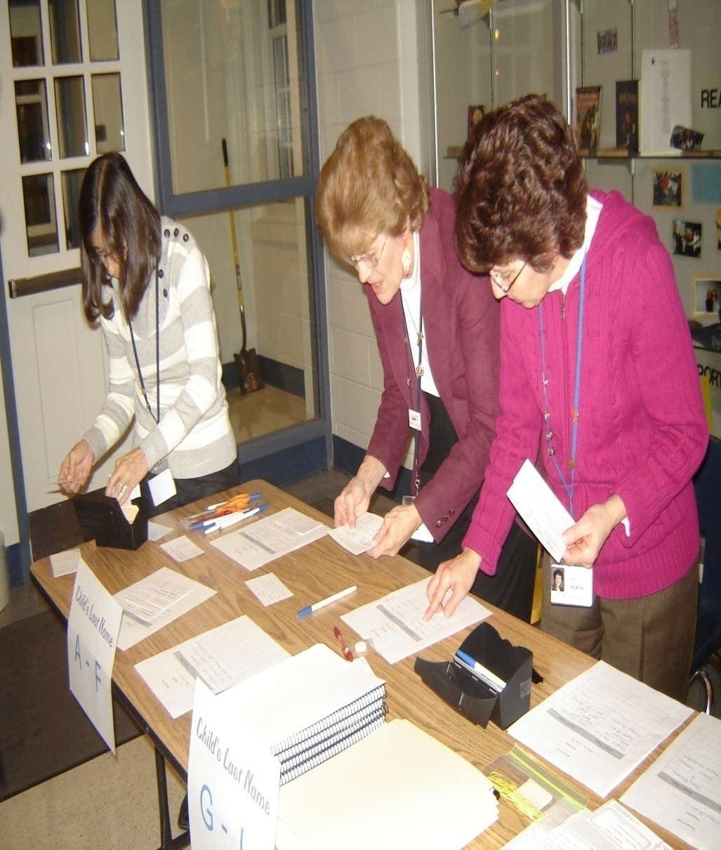
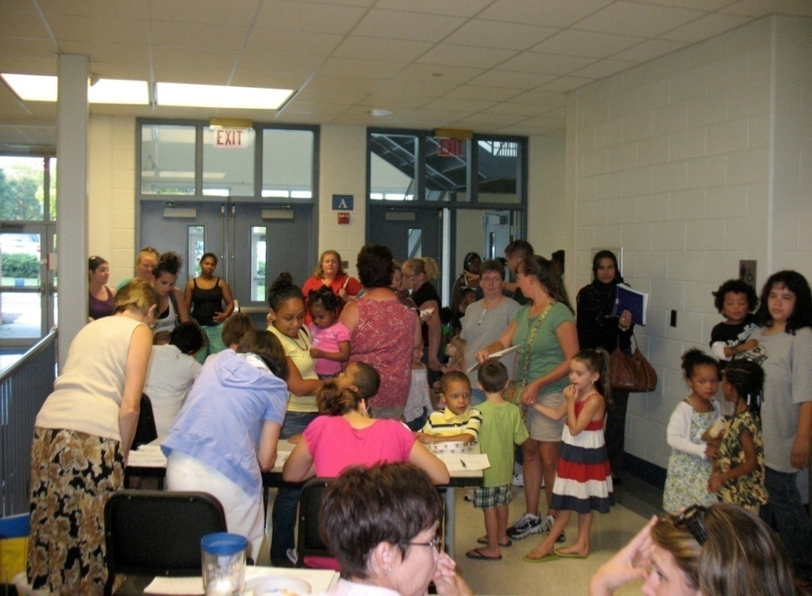
PLN Registration
5:30 pm – Registration - parents receive manual and registration materials, children go to Kids Track & Child Care
Notes:
File card for each family
name and age of children
name of parents
Dates blank for PLN
Files alphabetized by last name
Name tags made for parent & child
Adult tag blue include name of child
Child Red and include parent name
both tags include rooms numbers
Master list on spreadsheet for attendance tracking for attendance for grand prize
Break outs with same teacher
Name tag and raffle ticket
Assignments and escorts to kids track or child cared during main session

Slide 13
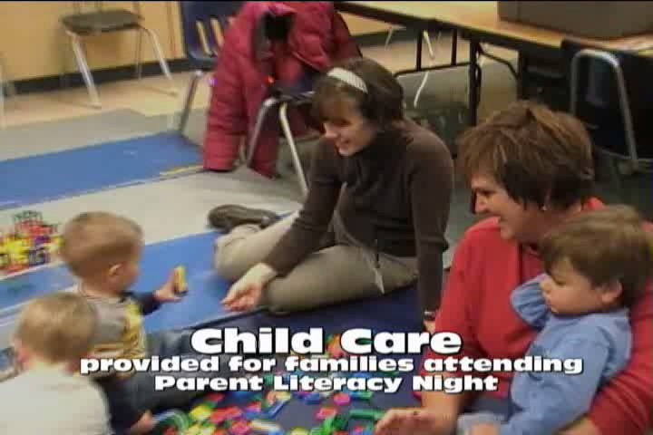
5:30 PM -Child Care
Provided for children who are not part of the PK, K, & Grades 1, 2, 3 or 4 targeted age group

Slide 14
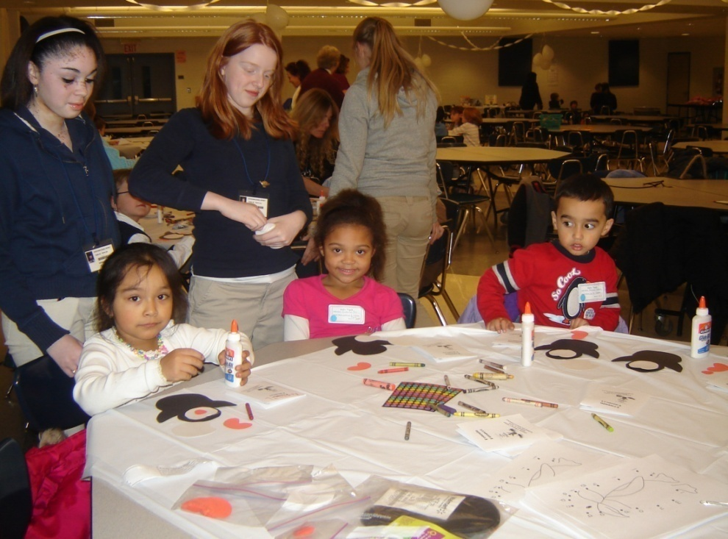
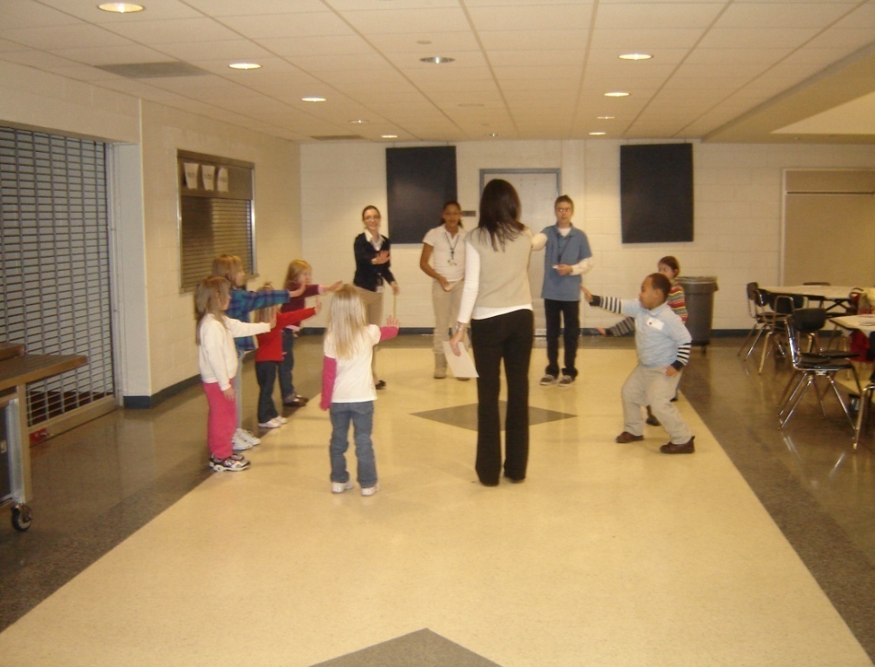
5:30 PM –
Kids Track
Students aged 3, 4, 5, 6, 7, 8, and 9 participate in thematic activities that focus on the literacy skill of the evening

Slide 15
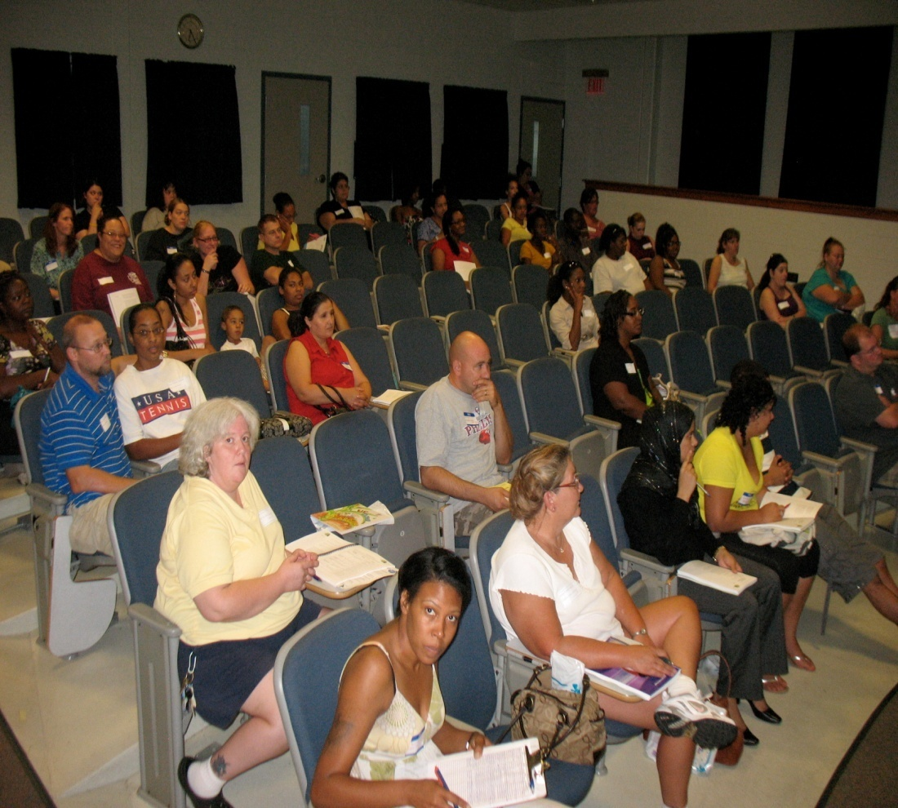
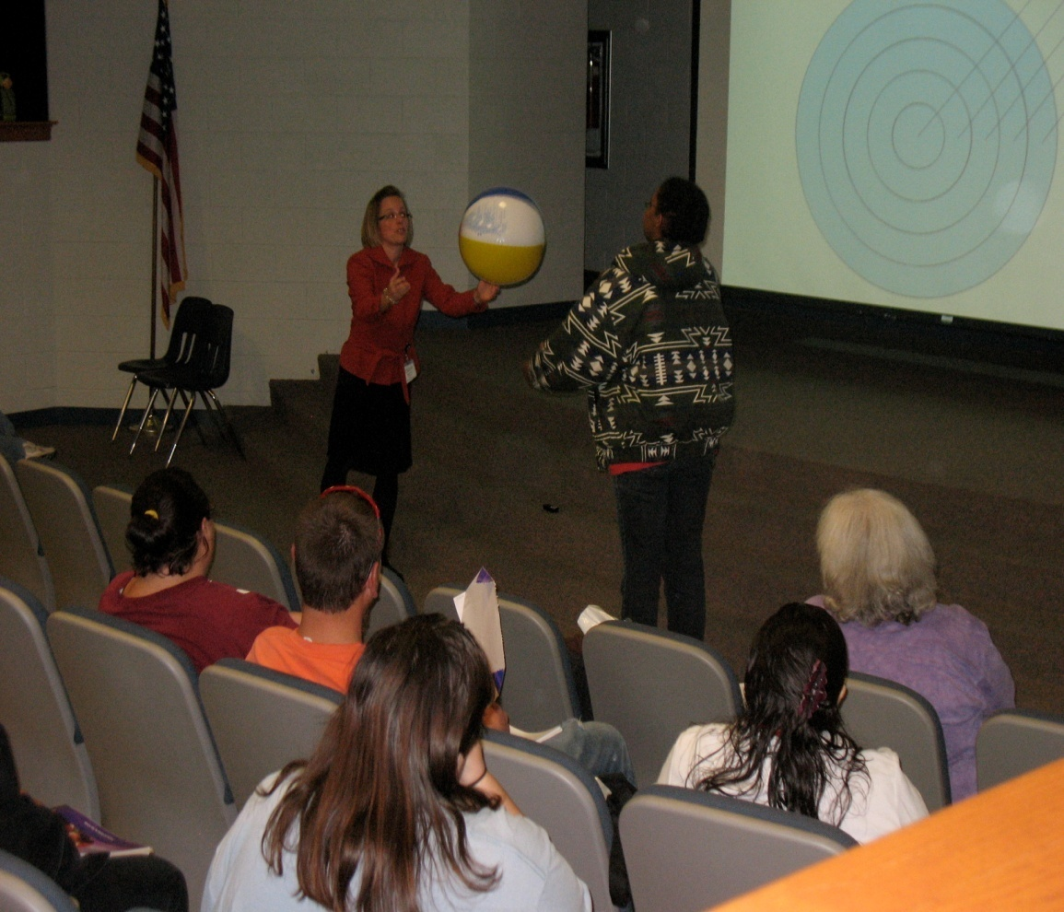
6 PM - General Session for Kindergarten Parents
Skill Focus
September 15th - Book and Print Awareness & Vocabulary Building
October 6th– Letter Recognition
October 27th - Language Awareness
November 17th- Phoneme Awareness
December 8th - Letter Sounds

Slide 16
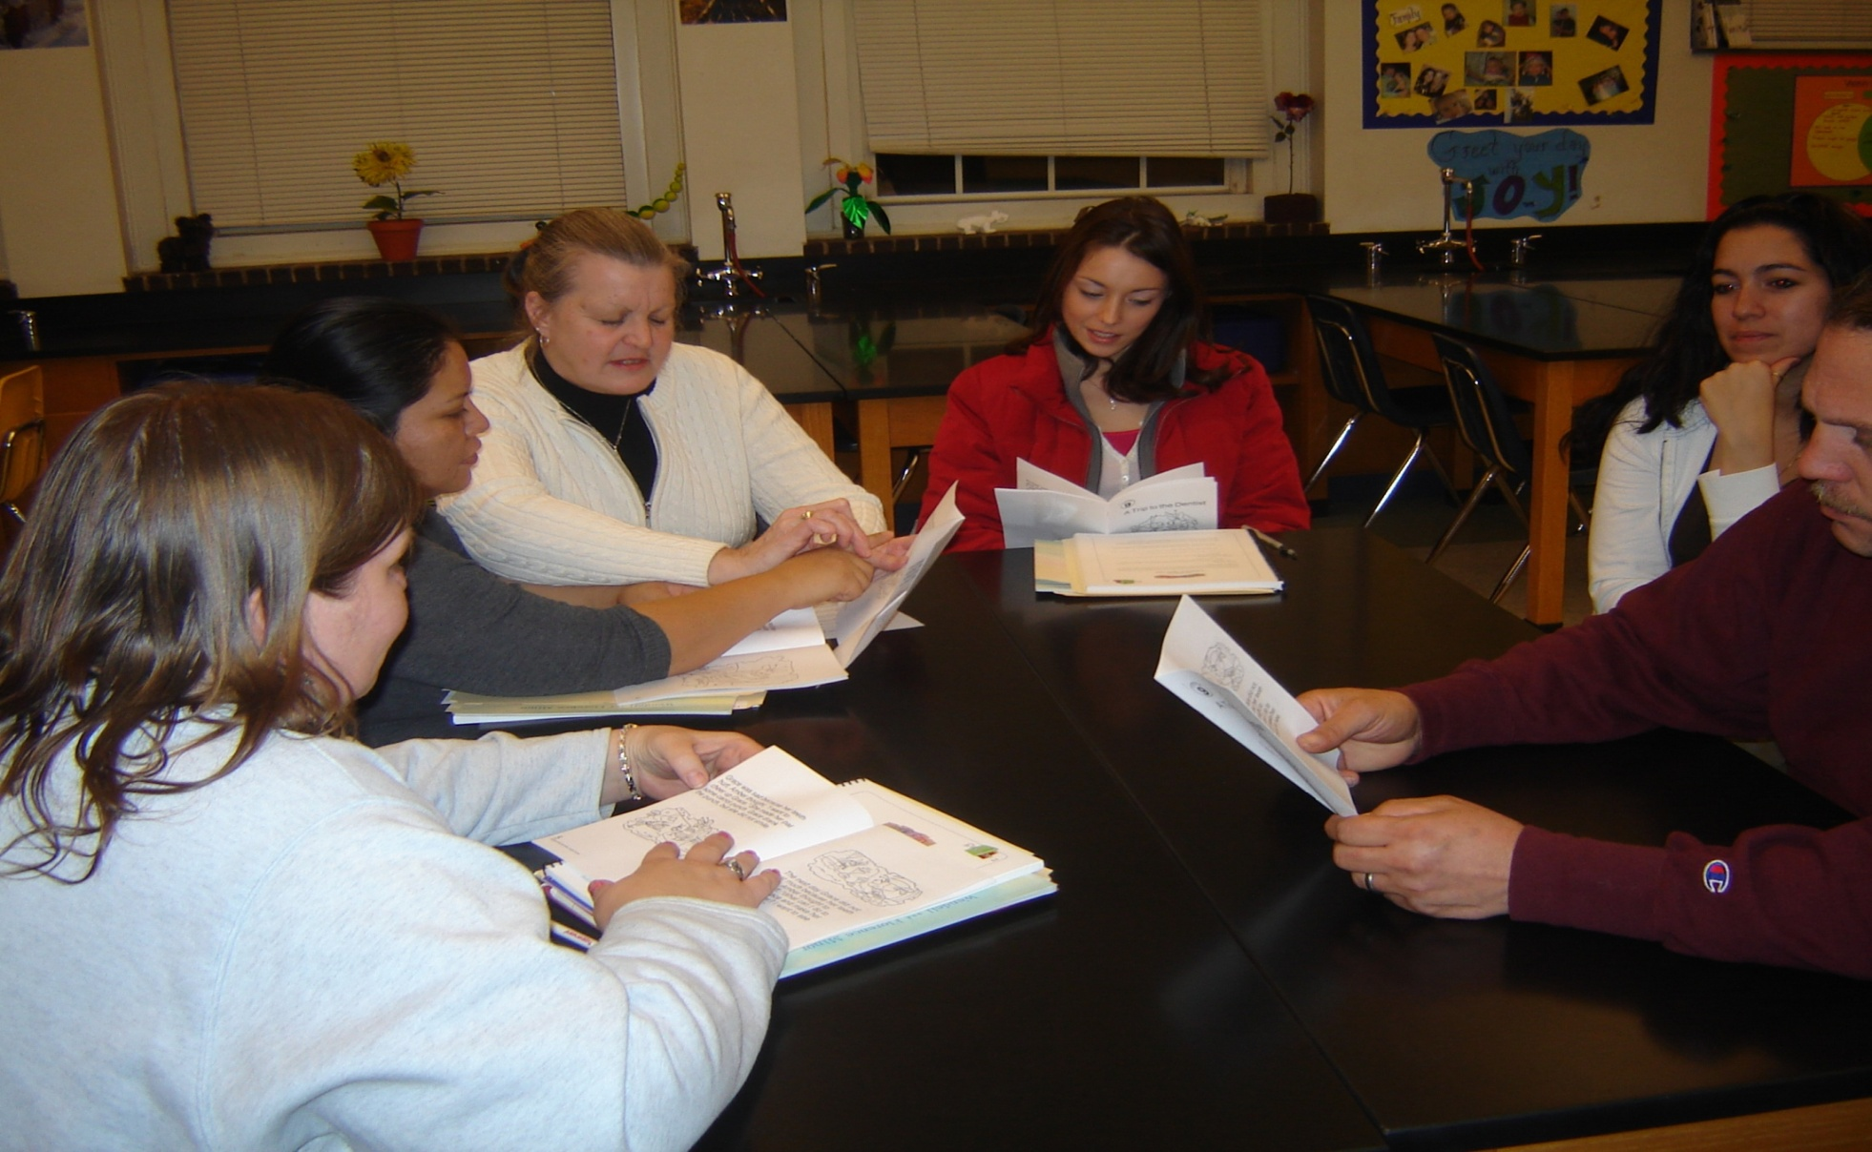
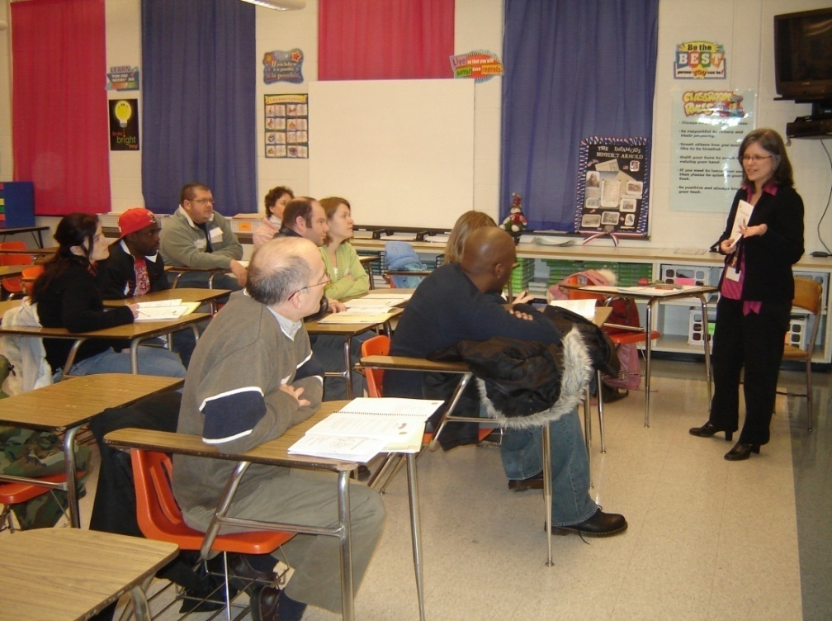
6:30 PM - Parent Breakout Sessions

Slide 17
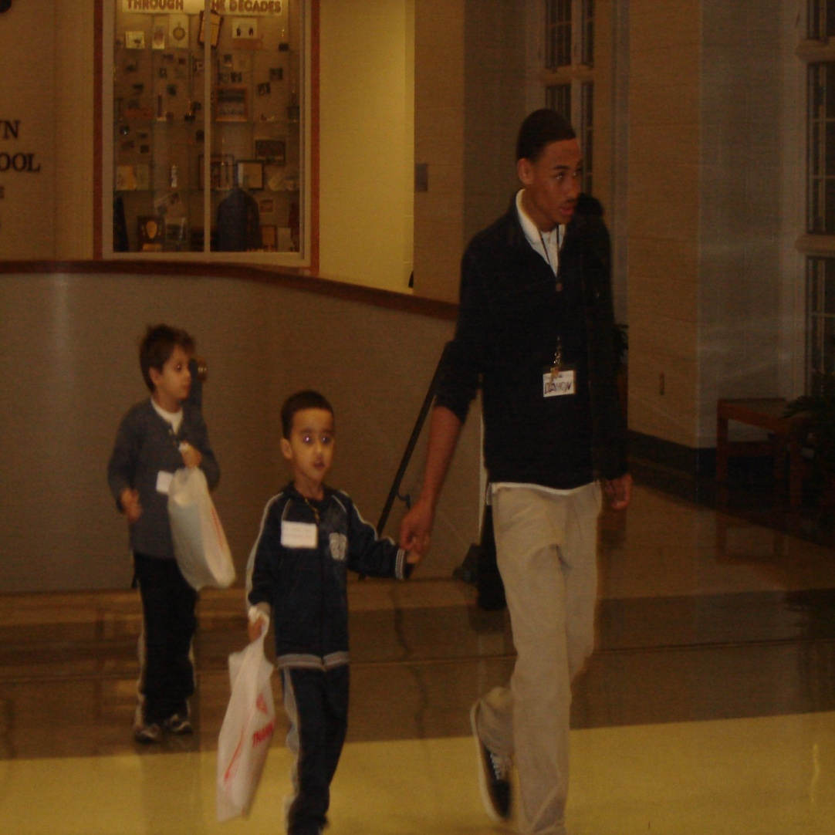
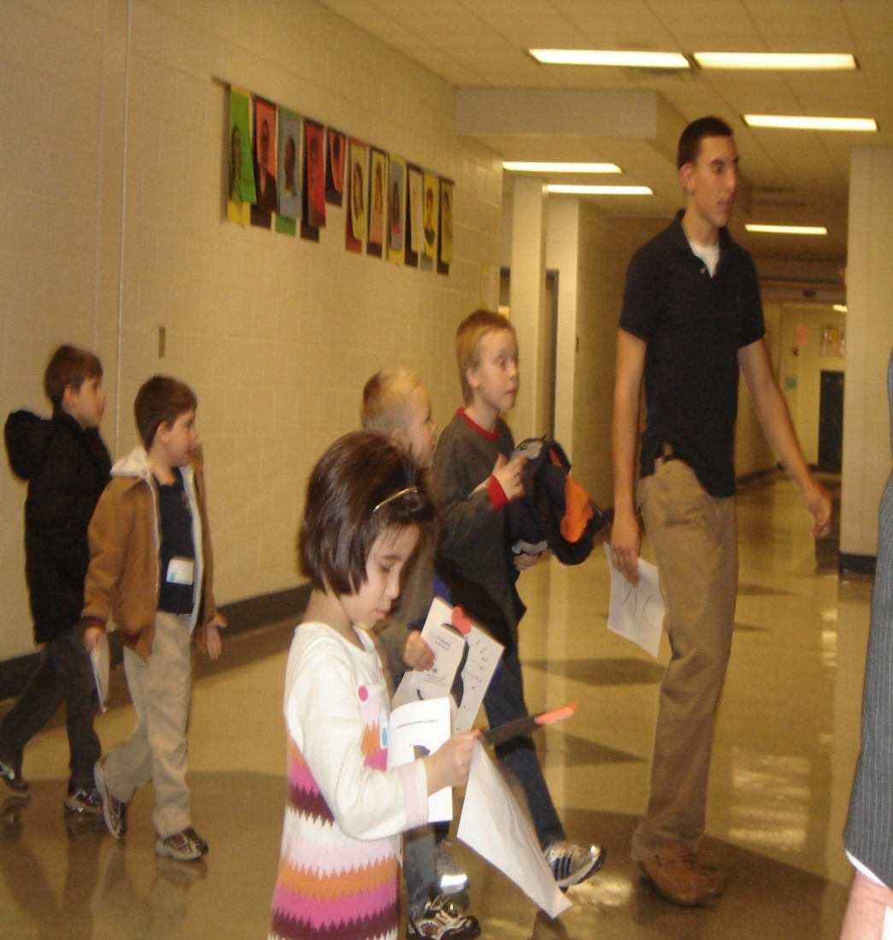
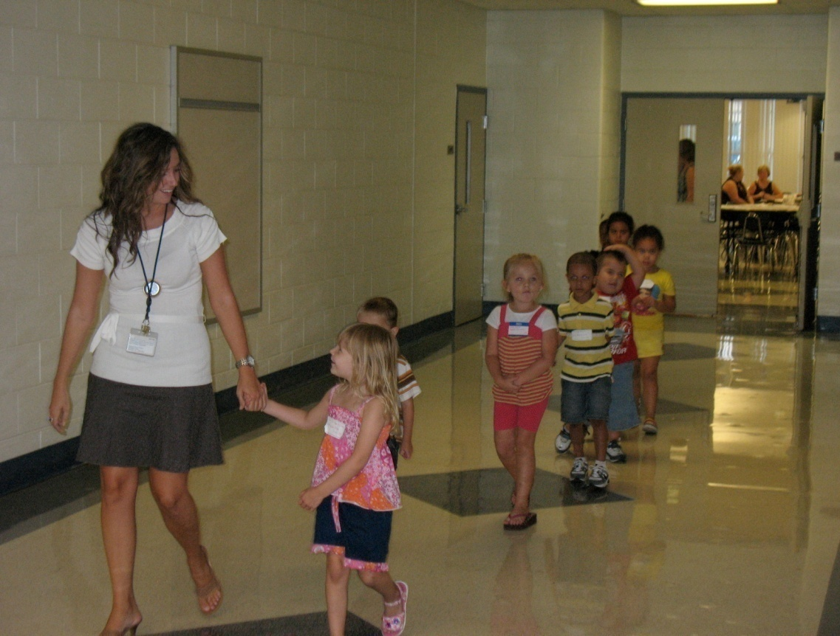
6:45 pm – Children Transition from Kids Track to Parent & Child practice sessions
Notes:
Volunteers; athletic teams – football, Lacrosse, track, volleyball, NJHS, Key Club

Slide 18
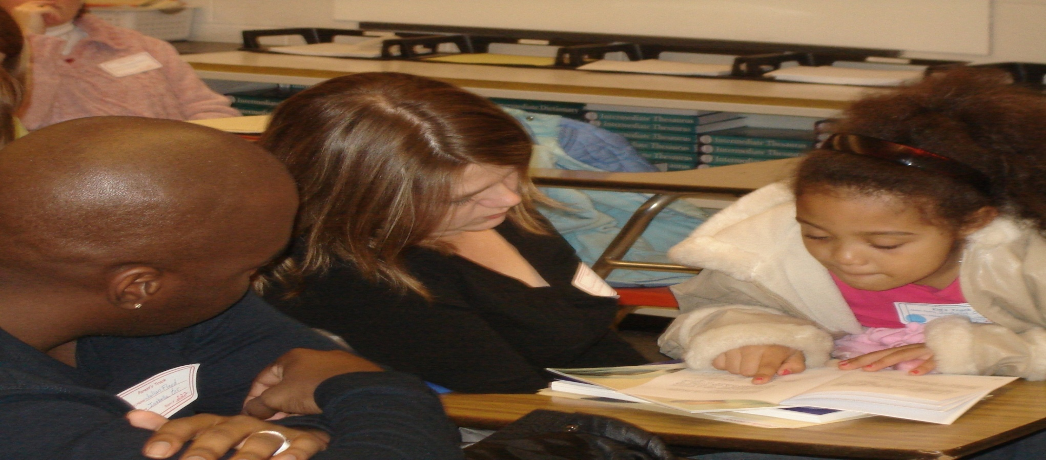
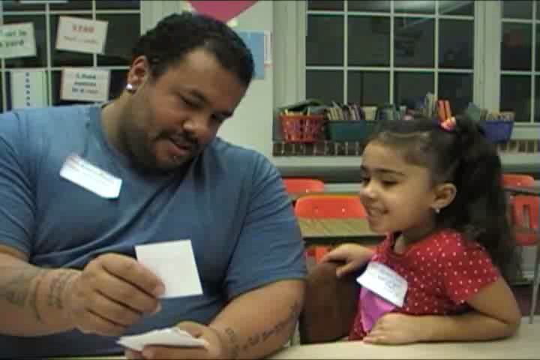

6: 50 pm - Parent & Child practice sessions with teachers

Slide 19
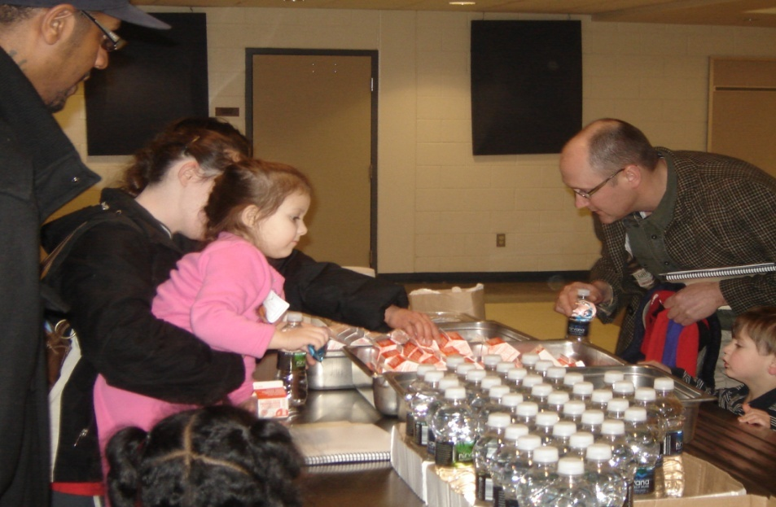
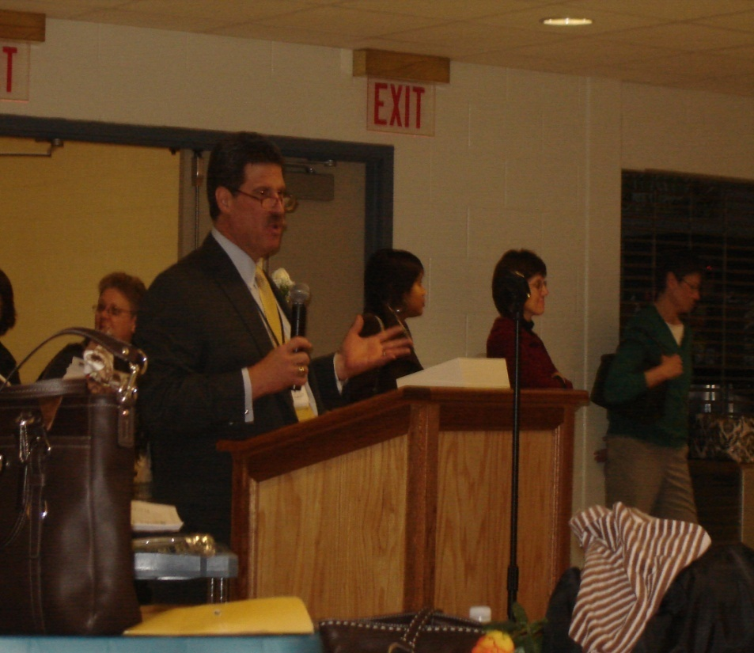
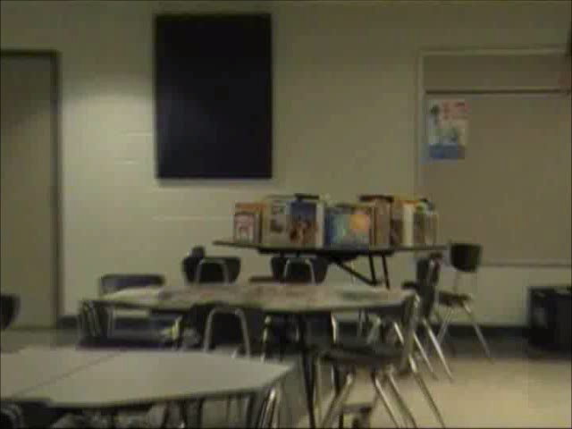
7:10 PM - Dismissal to cafeteria for Snacks, Gifts, Parent Reflection
Notes:
After each meeting parents complete a survey to
provide feedback on the value of the evening’s
activities and provide input on future event.
Raffle gifts, invectives – ed. games, book bags, subscriptions to Highlights magazine, children books, gift cards,
Enhance parent and child’s home library – free books every evening.
After each meeting parents complete a survey to
provide feedback on the value of the evening’s
activities and provide input on future event.
Assisting families in building home libraries
Books for Less; Friendly Coupons; books bags by age level; children books and cd and dvd’s; gift cards; educational games
Parenst who attend 5 of 6:
Refurbished Dell computer with Microsoft office suite load on it
Family Membership to YMCA
Family trip to the Zoo (Phila)
Gift cards to restaurants – 60 dollar value
Subscription to highlights magazine

Slide 20
Pottstown School District
Family Literacy Night Agenda
Dates: September 15; October 26 October 27; November 17; December 8
5:30 pm – Registration - parents receive manual and registration materials, children go to Kids Track & Child Care
6:00 pm - General session for parents
6:30 – Parent-teacher breakout sessions
6:45 pm – Children Transition from Kids Track to Parent & Child practice sessions
6: 50 pm - Parent & Child practice sessions with teachers-
7:10 pm - Dismissal to Cafeteria for refreshments and prize raffle

Slide 21
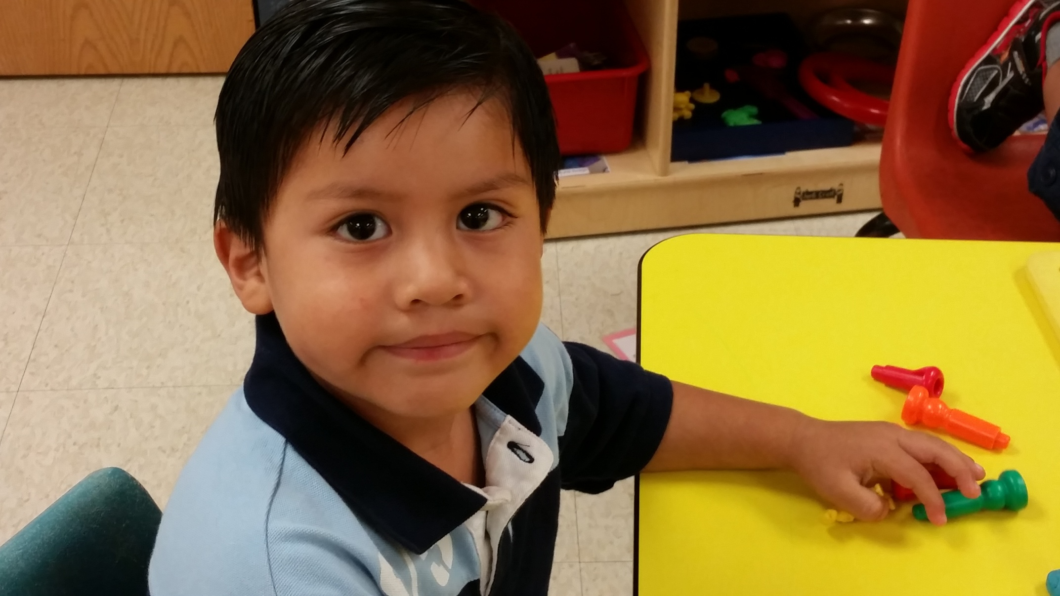
Quality Improvement & Work Force Development
Improving classroom quality and instruction
Raising credentials of work force
Ongoing professional development
Recruitment and retention strategies

Slide 22
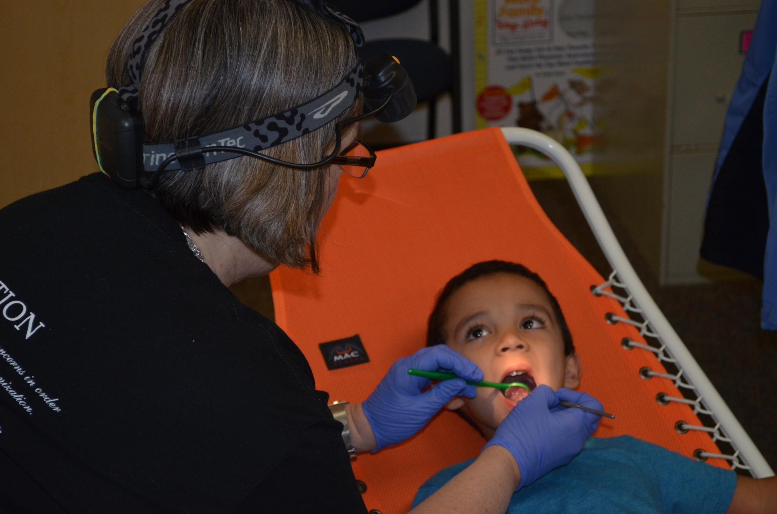
Health and Wellness
Hearing, vision, dental screenings
Fitness program
Nutrition program
Behavioral and social and emotional health

Slide 23
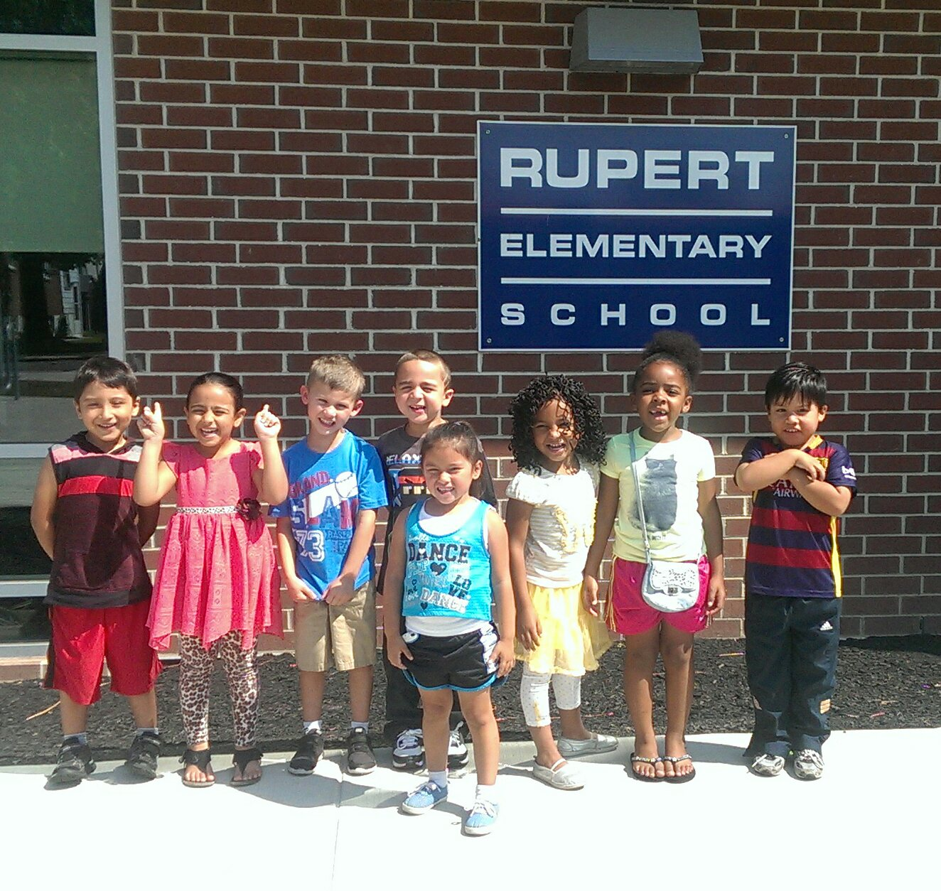
Kindergarten Transition
Joint professional development
Cross-classroom visits
Transition activities
Transfer of information to kindergarten
Summer kindergarten readiness classes

Slide 24
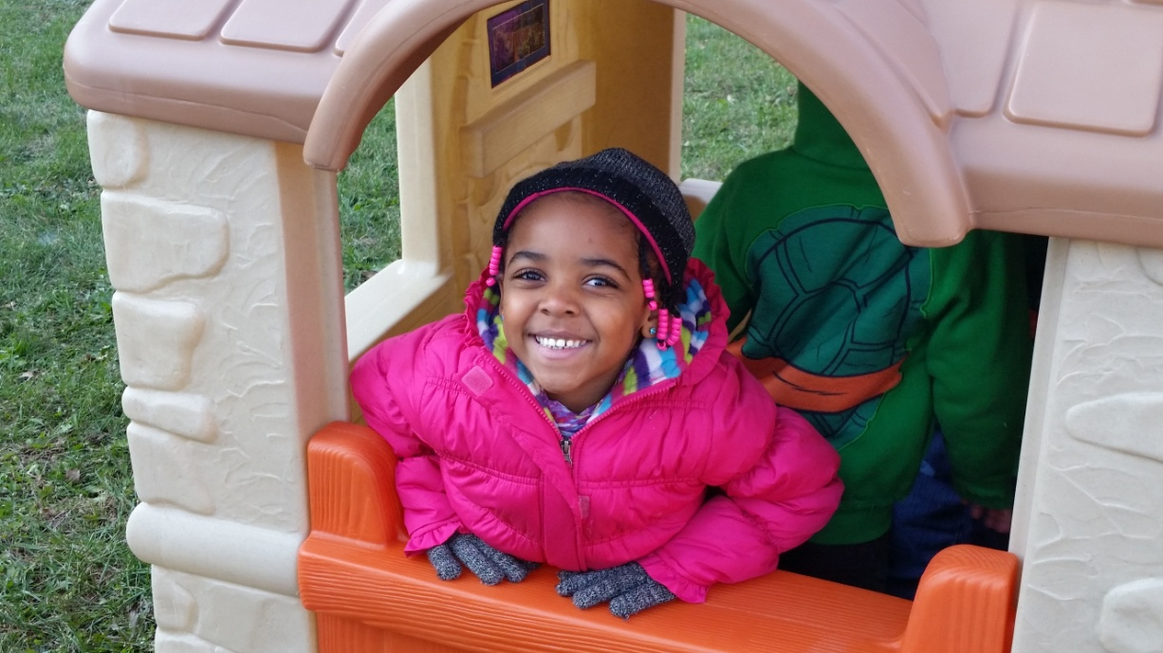
PA Pre-K Counts
Locating classes at community sites
Oversight and standards
Work force development
220 full day slots
3 and 4 year olds
Lead Agency support

Slide 25
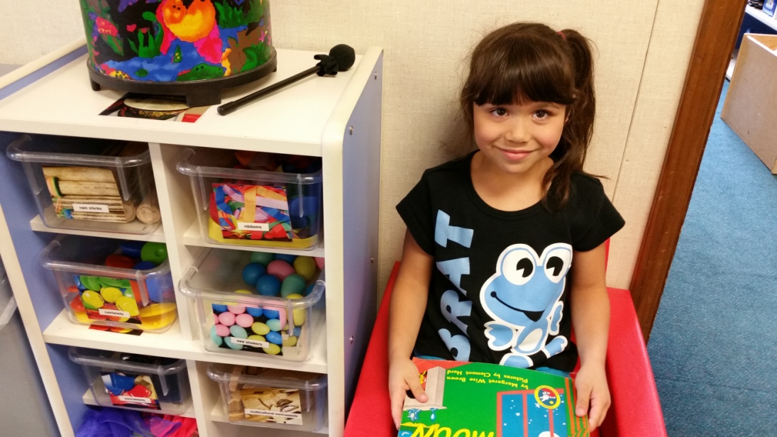
W. K. Kellogg Foundation
Connecting with Program Officer
Building relationship
Moving from a program orientation to a process orientation
Partnering with Penn Project for Civic Engagement
7 month planning grant

Slide 26
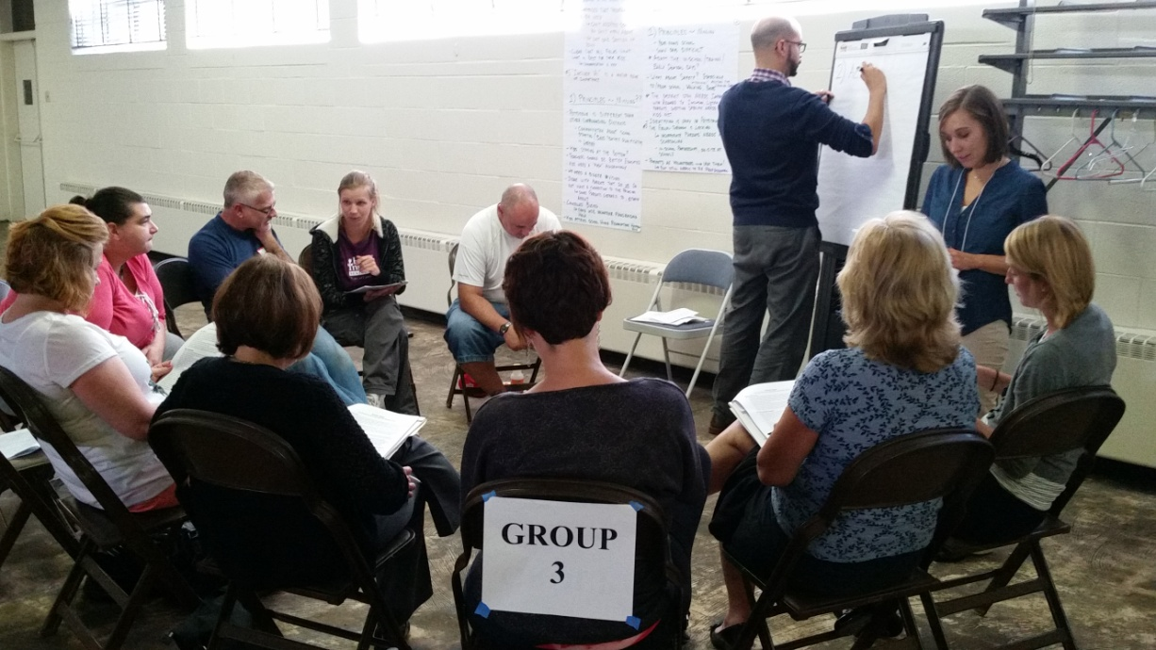
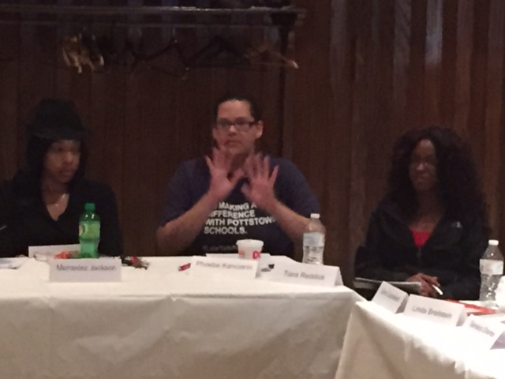
WKKF Planning Grant
Community Conversations
  To Identify needs and concerns of families
  5 Key Values Identified
Help Us to be better
Build Stronger Community
Address the Needs of Individual Children
“Talk” with Us
Include Us

Slide 27
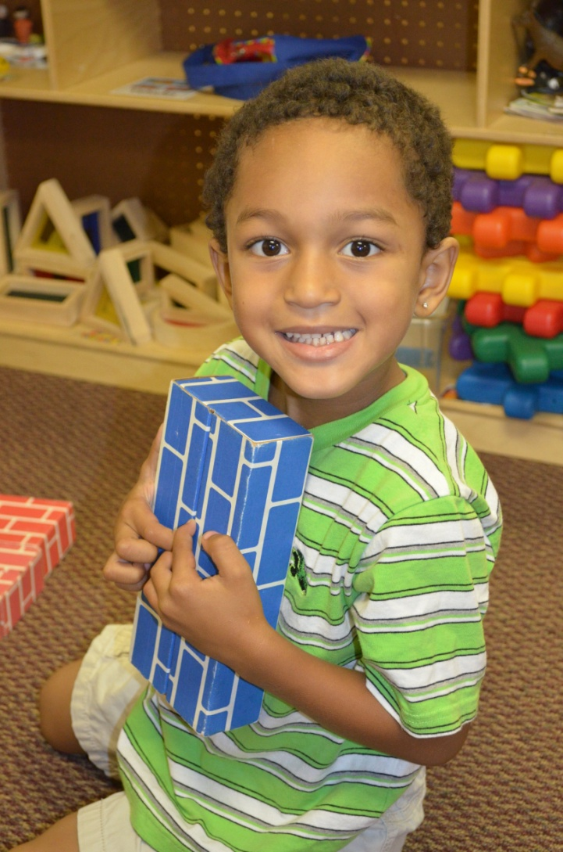
WKKF 3 Year Implementation Grant
Community Conversations
Spanish language outreach and support
Family Advisory Committee
Hard to Reach Families
Digital Media and Communications
Trauma and Adverse Childhood Experiences

Slide 28
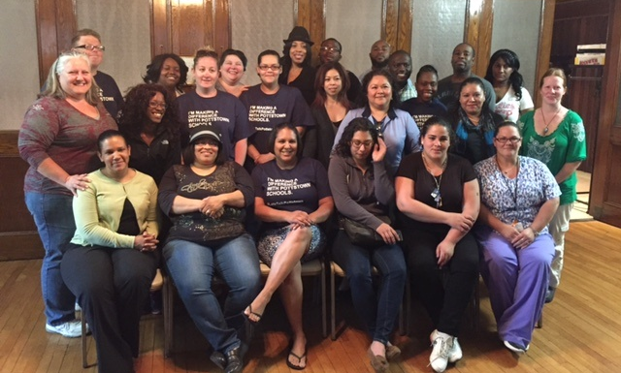
Family Advisory Committee

Slide 29
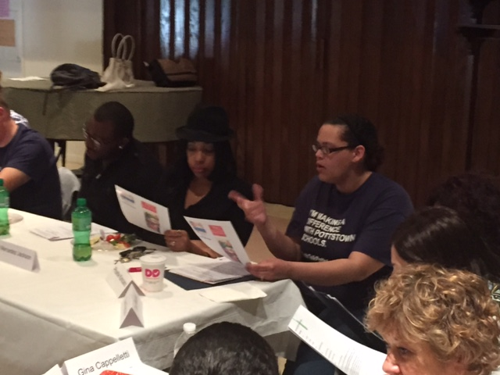
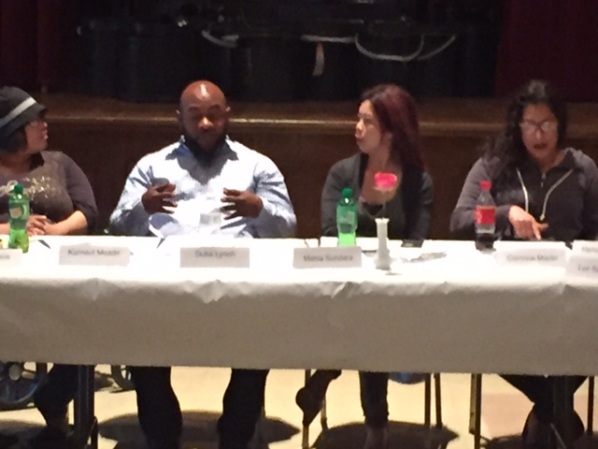
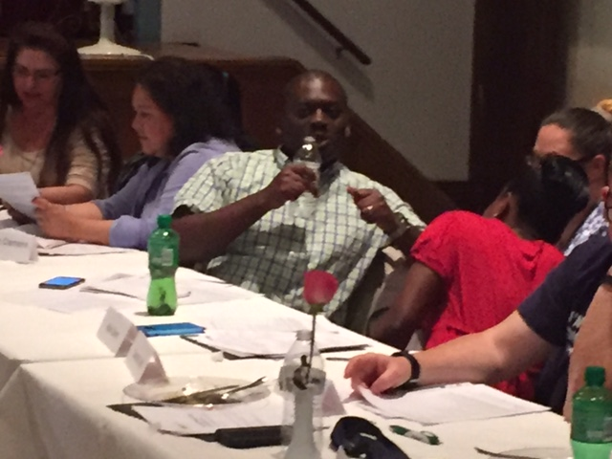
The FAC is building parent navigators (leaders)

Slide 30


Slide 31


www.pottstownmatters.org

Slide 32

Pottstown - A Trauma Informed Community
In Pottstown…
connection matters, belonging matters, your story matters.
In Pottstown…
Adverse Childhood Experiences/ACEs matter.
In Pottstown…
we are committed to a culture of safety, understanding and responsiveness to ACEs for children, families and our community.
www.pottstownmatters.org

Slide 33
Notes:
Are we making a difference for kids and families? Our children who participate in the high quality community based Pre-K classes are entering kindergarten better prepared and they are sustaining those gains throughout elementary school. The red bar is the Pre-K Counts students compared to the overall district average. The students entered kindergarten ahead of the district average and those same students are now in fourth grade and still scoring substantially above the district average.

Slide 34
Increase in Family Involvement

Slide 35
PEAK Funding Sources
Pennsylvania Pre-K Counts (Commonwealth of PA)
W. K. Kellogg Foundation
Pottstown Area Health & Wellness Foundation
United Way of Greater Philadelphia and Southern New Jersey
Community Innovations Zone
Other Foundations and Donations

Slide 36
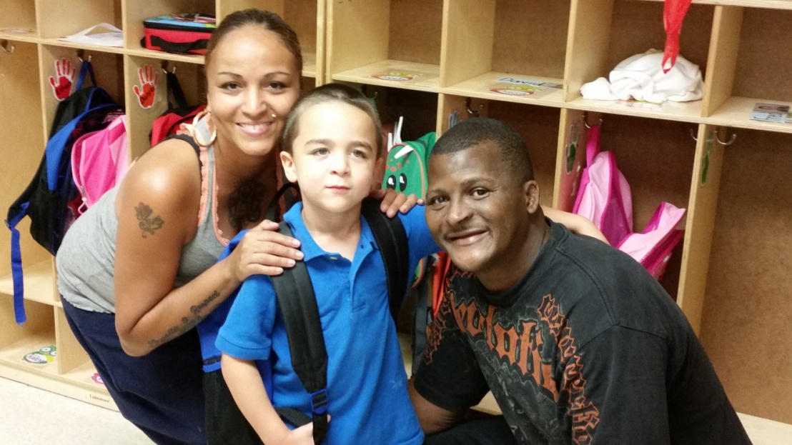
Looking to the Future
Trauma awareness
0-3 outreach
Sustainability
Social Emotional Learning

Slide 37


Slide 38

Key Factors for Success
District leadership
Understanding of both public and private settings
Support of key stakeholders in community
Community partnerships
Look to future and adjust as needed
Keep vision in mind

Slide 39

Changing a Community

Slide 40
Jeff Sparagana, Ed D
Superintendent of Schools jsparaga@pottstownsd.org
610-970-6001
@JeffSparagana
Mary Rieck
PEAK Coordinator mrieck@pottstownsd.org
610-970-6655
@PEAKPartners
Pottstown Early Action for Kindergarten Readiness

